Slide 1
Introduction to Probability and Statistics
4CM521
Introduction

Slide 2
Contact Information
Lecturer: Dr Jack Sutton
School of Computing and Mathematics
Markeaton Street, Room MS104
e-mail: j.sutton@derby.ac.uk

Slide 3
Module Outline
This term will expose you to a range of common statistical methods.
We are using R to perform analysis using a range of methods- understanding the underlying theory and being able to interpret R output are more important than being able to get a routine working.
You are very strongly encouraged to take the time to see just how these functions work.
There are worked solutions available for selected problems, but don’t just type in commands- make sure you understand (and experiment with) the logic of the various procedures.

Slide 4
Topics
R
Organising and presenting data
Descriptive statistics
Sets and an introduction to probability
Discrete and continuous random variables and their probability distributions
Properties of random variables
Discrete and continuous probability distributions
Mean and variance of linear combinations of random variables
Moment generating functions (MGF)
Maximum Likelihood Estimation (MLE)

Slide 5
Learning Outcomes
The key learning outcomes of this term are:
  Apply probabilistic methods to solve real-world problems
  Demonstrate knowledge and understanding of a range of fundamental concepts in probability theory and applications.

Slide 6
Assessment Methods
There will be two summative components which each carry 50% of the overall mark:
  Coursework
  Examination
Your progress will be monitored throughout the term and formative feedback will be provided.
Informal feedback will be given to you during the seminars, with references to worksheets, as a group and on an individual basis.
Comments will be given on the coursework and exam which will be handed back to you.
Please refer to the Introduction to Probability and Statistics Assessment Briefs for more detailed information about what is expected in each assessment.

Slide 7
Teaching and Learning
Teaching Style
The lectures are designed to introduce new material.
The tutorials will be computer guided (although myself and possibly another lecturer will be in attendance) to make sure you are clear what you need to take from the sessions.
Self Study
The advice given is that for every hour that you spend in classes, you should spend at least another hour working on this module in your own time.
You will also need to spend a substantial amount of time working on coursework.

Slide 8
Teaching and Learning
Make sure you have a full set of notes and can answer the problems in the notes. Should you have to miss a class it is important that you catch up on what you miss from a friend.
Read through the notes and make sure you understand them.
  Highlight anything which does not make sense to you and discuss it with a friend.
  You are also welcome to ask me about any part of the notes which you don't understand.
  Either catch me at the end of a lecture or during a tutorial class.
  You are also welcome to e-mail me or to come to find me in my office

Slide 9
Teaching and Learning
Do some supplementary reading.
  Have a look at corresponding chapters in the recommended books or have a glance through other books in the library.
  The methods and techniques taught on this module are such important topics that there are many great web-resources
  It is good to see how different people approach the same problem in different ways
  Also, you might find more interesting applications - let me know!
Do finish off any problems in the notes which you don't get time to complete in class.
  After the first few weeks, these tutorials are designed to help consolidate your understanding of the material we cover in the lectures, so it is essential that you work through these exercises.
  By adopting a systematic approach, you will save yourself a great deal of time when you come to revise for the exam.

Slide 10
Useful textbooks
Rees, D. G. (2001). Essential Statistics (4th ed.), Chapman and Hall.
Rizzo, L. M. (2019). Statistical Computing with R (2nd ed.), CRC Press
Blitzstein, J.K., & Hwang, J. (2014). Introduction to Probability (1st ed.). Chapman and Hall/CRC.
Mavrakakis, M.C., & Penzer, J. (2021). Probability and Statistical Inference: From Basic Principles to Advanced Models (1st ed.). Chapman and Hall/CRC.

Slide 11
R
In this module we use RStudio which is a premier integrated development environment for R.
It is available in open source and commercial editions and runs on the desktop (Windows, Mac, and Linux) or over the web with RStudio Server.
You can find more information by visiting the following websites:
  http://www.rstudio.com/
  http://www.r-project.org/

Slide 12
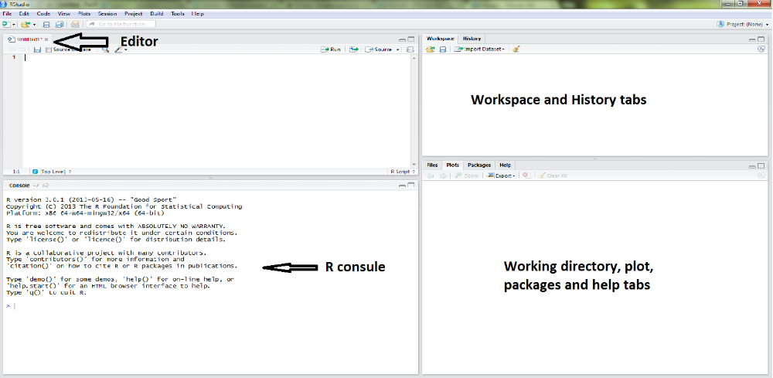

Slide 13
Tutorial
Introduction to R
Learn simple command

